Slide 1
Introduction to Python
These notes were originated from Dr. Priyanka Chaurasia’s notes from her
Data Science Foundations module at Ulster University, and, with permission from
Dr. Chaurasia, edited by Farajollah Tahernezhadjavazm, Przemyslaw Cichy and
Dr. KongFatt Wong-Lin for the ISRC-CN³ Autumn School.
Attendees, especially those who are not too familiar with programming or Python,
should go through these notes before attending the Autumn School
– the lab session on Day 1 will discuss only selected parts of the materials.

Slide 2
Python programming (Part 1)

Slide 3
Python
Released in 1989
Current version: 3.9.0 (January 2021)
Simplicity -Precise, efficient, readable syntax
High-Level – abstracts details such as memory management
General purpose – AI, statistics, visualisation, etc.
Comprehensive libraries - analysis, machine learning, visualisation
Interpreted language – evaluation of code happens immediately, rather than going through a compile and run cycle
Recommended for those with a Computer Science / Software Engineering background

Slide 4
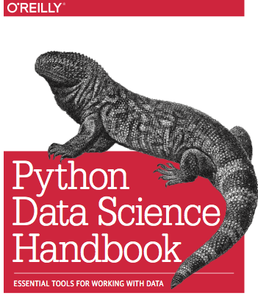
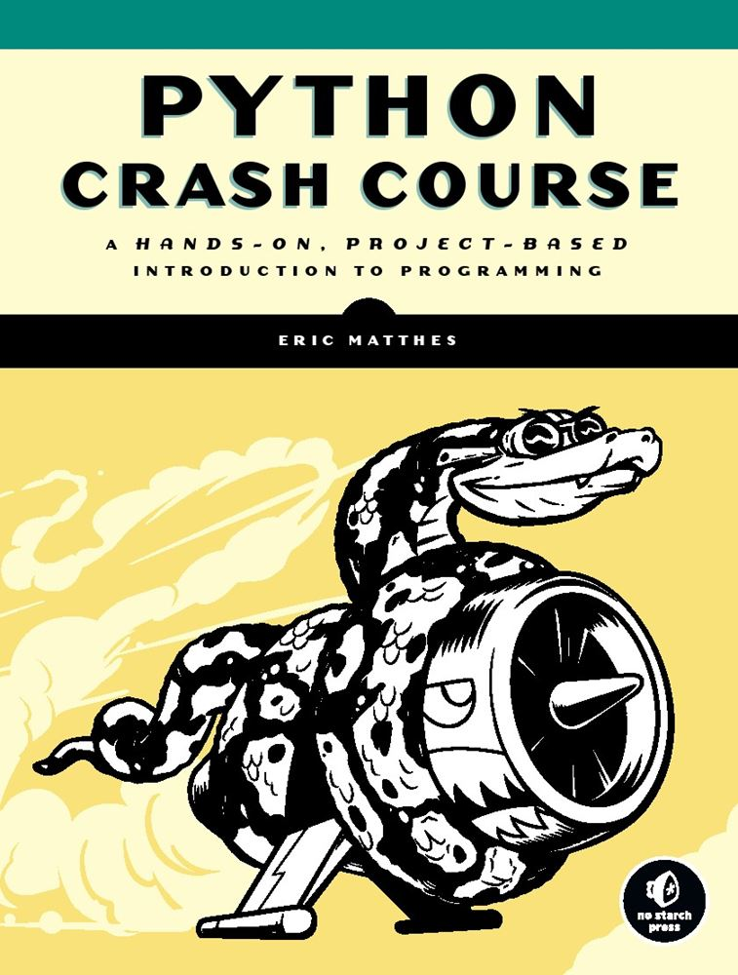
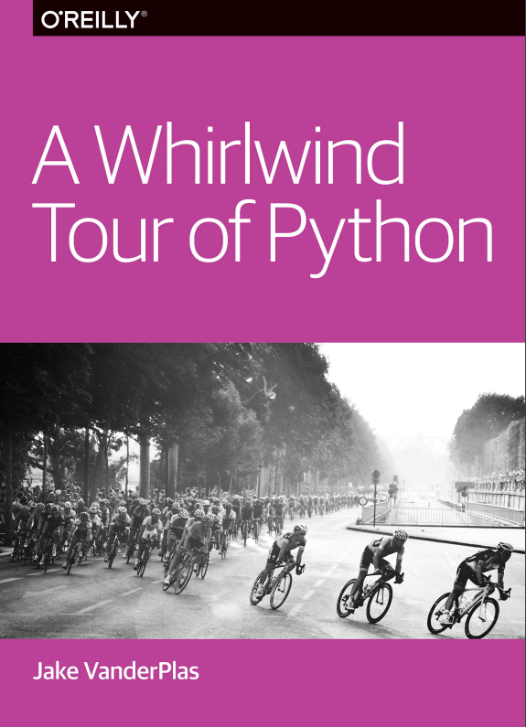
Learning Python-Free Learning Resource
https://github.com/jakevdp/PythonDataScienceHandbook | https://github.com/MrAlex6204/Books/blob/master/python-crash-course.pdf | https://www.oreilly.com/programming/free/files/a-whirlwind-tour-of-python.pdf
http://python.org/
- documentation, tutorials, beginners guide, core distribution, ...

Slide 5

Installing Python
Easiest method: Use Anaconda
A free Python package manager
Can be used to install and update Python Packages
Including all dependencies
Both a Command Line Interface and GUI
Already installed in the labs
For home use and documentation: https://docs.continuum.io/

Slide 6
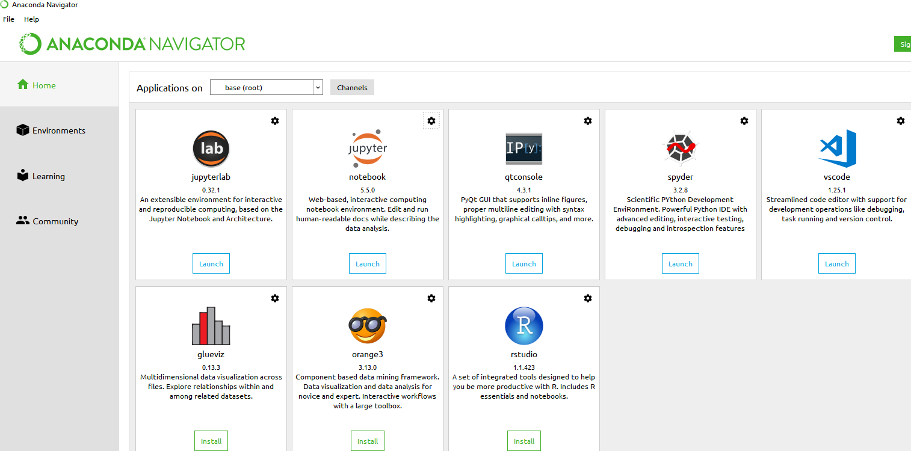
Anaconda
GUI

Slide 7
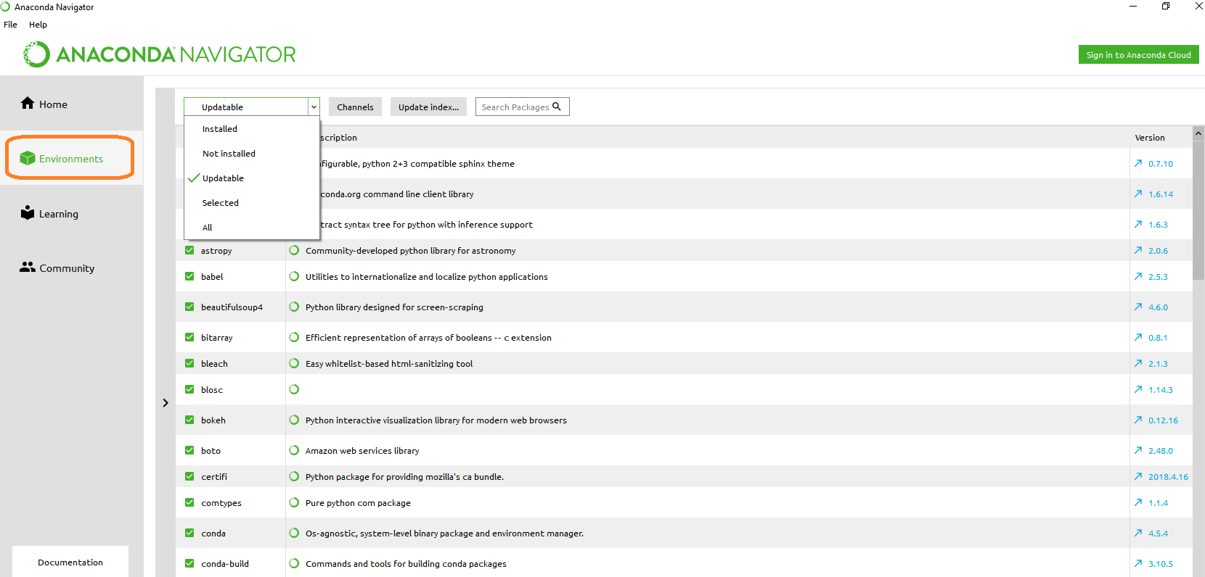
Anaconda
Installed Packages and Version

Slide 8
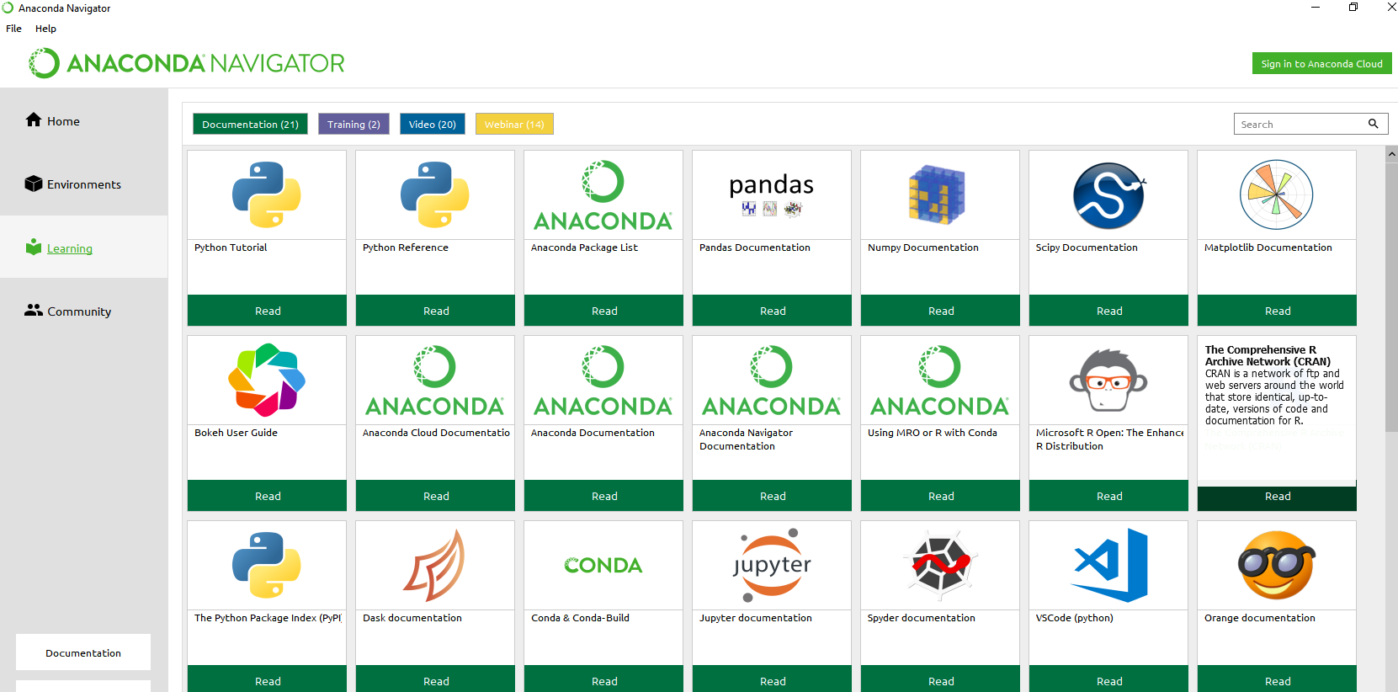
Anaconda
Learning materials

Slide 9
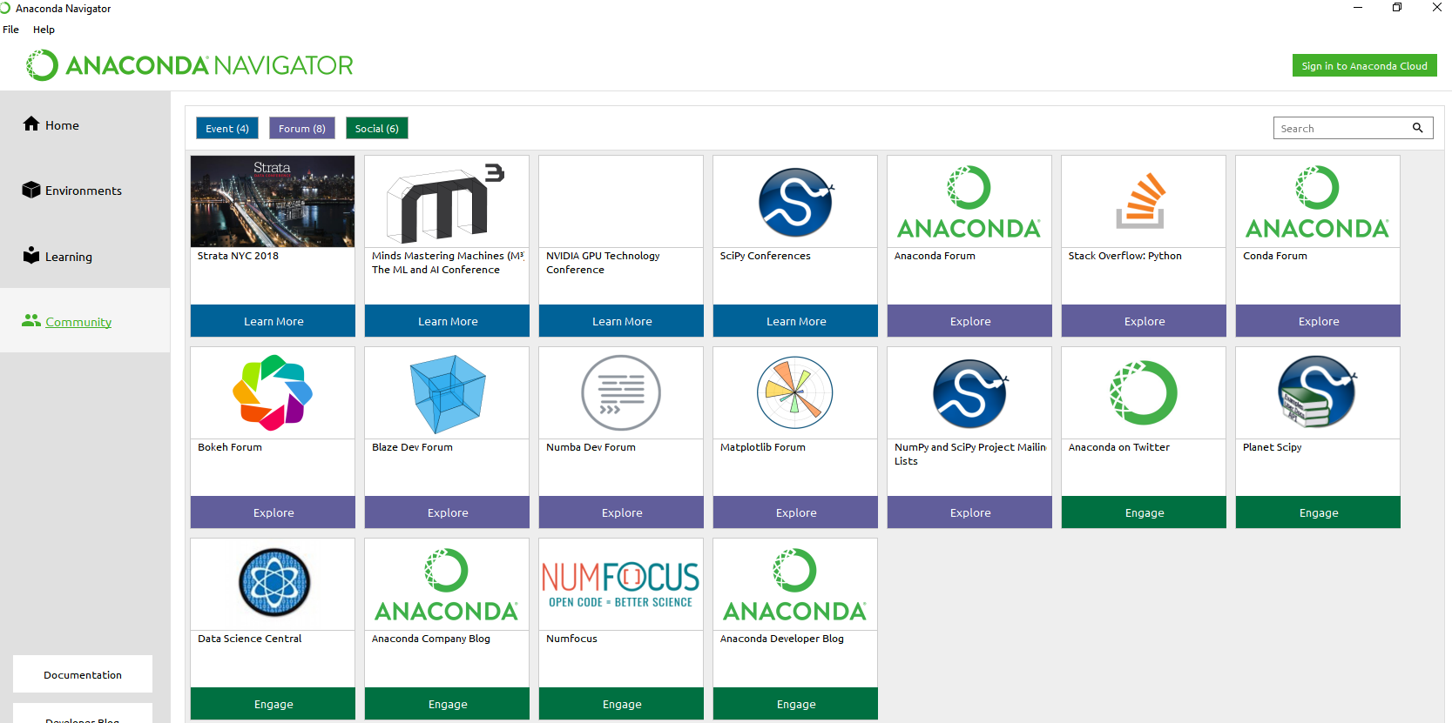
Anaconda
Access to community:

Slide 10
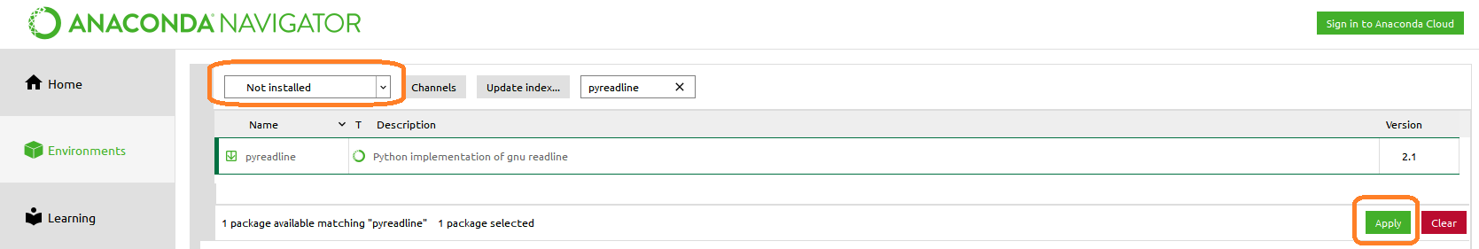
Jupyter Notebook
A web application to create documents with live code, visualisations, images and text
Ideal for beginners and advanced users
Jupyter = Julia, Python, and R – the first languages supported
Main Components:
Kernel – Runs and inspects user code
Dashboard – For access to all notebooks created, and for control over the kernel
To enable Tab Completion, ensure the “pyreadline” package is installed

Slide 11
Jupyter Notebook
Allows segments of code to be re-run quickly
Assess impact, experiment, debug
View code and output together
Annotate and share code
Host remotely, (e.g. high powered server), access anywhere

Slide 12

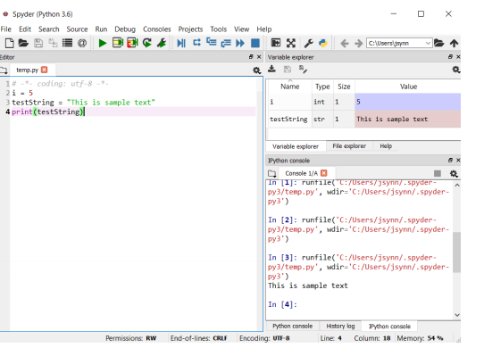
Spyder
Scientific Python Development IDE
Full featured IDE. Ideal for larger codebases
Syntax highlighting
Exploration and editing of variables from a GUI

Slide 13
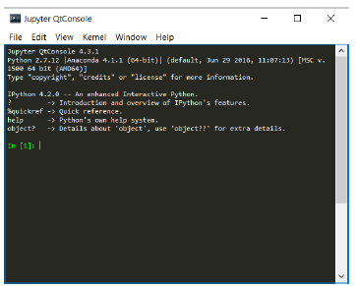
Jupyter QtConsole
A very lightweight application, acts like an “enhanced terminal”
Useful for quickly checking Python object help documents
Also supports inline figures, multi-line editing, syntax highlighting etc.
For this module I recommend using Jupyter notebook

Slide 14

Working with Jupyter Notebook
Launch the Jupyter Notebook from Anaconda Navigator

Slide 15
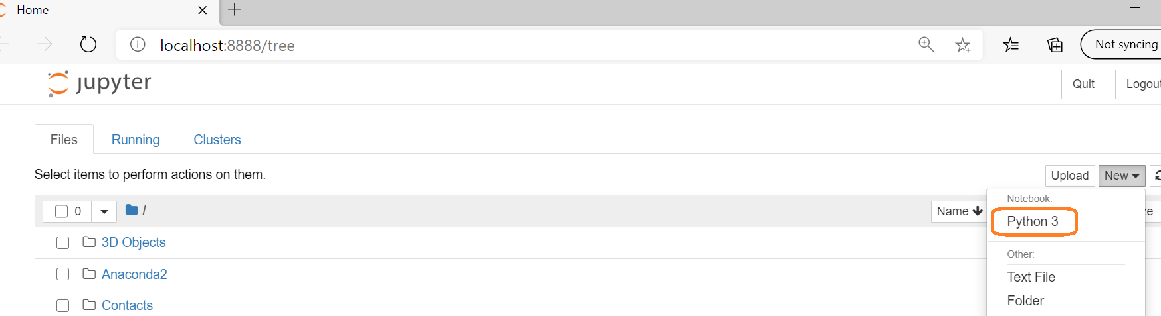
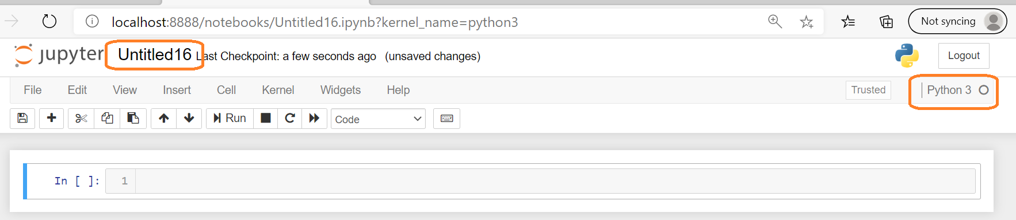

Slide 16
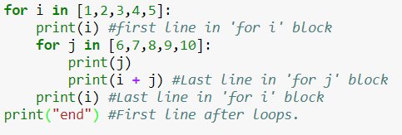
Python Fundamentals
Whitespace Formatting
Python uses indentation to delimit blocks of code.
Other languages use curly brackets { }
E.g.
Whitespace within lines has no impact

Slide 17
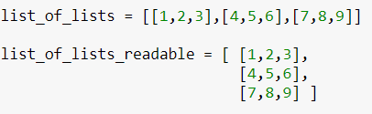
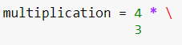
Python Fundamentals
Whitespace Formatting
Ignored inside:
Parentheses (round brackets) – ( )
Curly brackets, aka. Braces – { }
Brackets, aka. Square Brackets – [ ]
* Both variables are same. But the second one is more readable presentation
You can also use a backslash to continue a statement on a new line

Slide 18
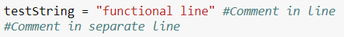
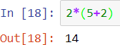
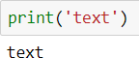
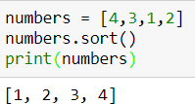
Python Fundamentals
Comments:
Parenthesis ()
Used for grouping mathematical operations:
And to indicate a function is being called:
Note: Must be used during a function call even if no parameters are being supplied:

Slide 19
Python Fundamentals
Terminology
A statement is an instruction that the language implementation understands. In most languages, statements do not return values.
A function is a subroutine that can be called elsewhere in the program. They often return values.
A control structure is a statement that can be used to direct the flow of execution (e.g. an if statement)
An expression is a piece of code that evaluates to a value (e.g. 1+3)

Slide 20
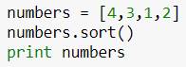
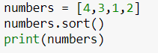
Python Fundamentals
The print function
Something you will notice when following online tutorials:
Python 2.x – print acts is a statement
Python 3.x – print is a function

Slide 21
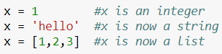
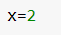
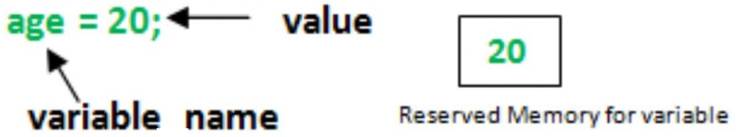
Python Fundamentals
Variables
In Python, these are pointers to a bucket in memory, e.g.:
This is defining a pointer, called x
This pointer points to memory bucket, containing the value 2
Therefore:
Python variables just point to various objects
A variable can be assigned to different object types
There is no need to declare the variable or its type (e.g. int x = 2)
Python is dynamically typed to its variable type

Slide 22
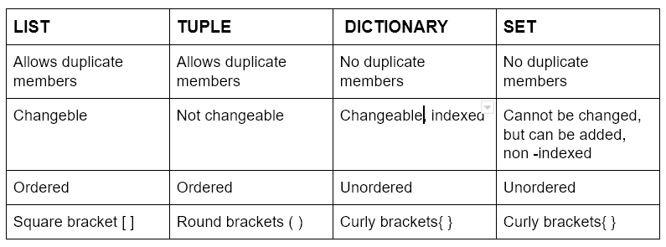
Python Fundamentals
Python Collections (Arrays)- Built-In Data Structures
There are four collection data types in Python:
List - ordered and changeable. Allows duplicate members
Tuple - ordered and unchangeable. Allows duplicate members
Set - unordered and unindexed. No duplicate members
Dictionary - unordered, changeable and indexed. No duplicate members

Slide 23
Python Fundamentals
Built-In Data Structures- Collection types
Aka Compound types
Act as containers for other types
These are:
Type Name | Description | Example
list | Ordered collection | [1, 2, 3]
tuple | Immutable ordered collection | (1, 2, 3)
dict | Unordered (Key, Value) mapping | {‘a’:1, ’b’:2,’ c’:3}
set | Unordered collection of unique values | {1, 2, 3}

Slide 24
Python Fundamentals
Built-In Data Structures
Lists
Ordered and Mutable.
Definition:
Useful properties and methods:
Property/Method | Description | Example
len() | Return the number of elements in the list | len(animals) returns 3
append() | Add the supplied object to the end of the list | animals.append(“elephant”)
Concatenation | Combine two lists | animals + [“cow”,”eel”]
sort() | Sorts in ascending order. | animals.sort()

Slide 25
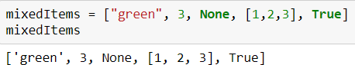
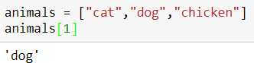
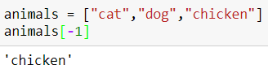
Python Fundamentals
Python index starts from 0
Built-In Data Structures
Lists
Can contain multiple data types simultaneously:
Indexing and Slicing allow access to specific elements.
Indexing
Single elements, using a zero-based index.
Negative indexes allow us to start from the end of the list:

Slide 26
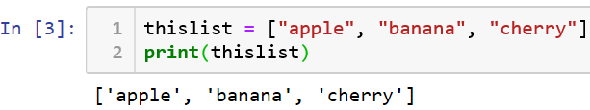
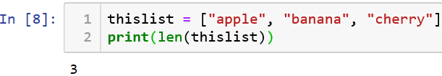
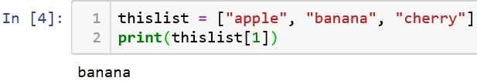
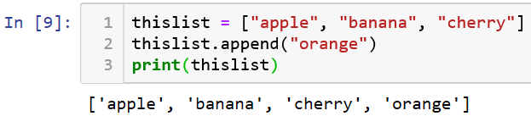
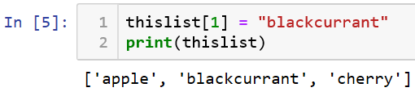
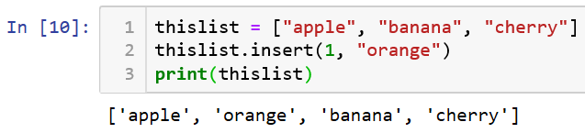
Python Fundamentals
List
List Length
Access Items
Add Items
To add an item to the end of the list:
use the append() method:
Change Item Value
Loop Through a List
To add an item at the specified index:
use the insert() method:

Slide 27
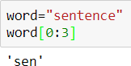
Python Fundamentals
Built-In Data Structures
Lists
Slicing
Facilitates accessing multiple values in a list
Use the format: listName[firstIndex:lastIndex]
Note that first Index is inclusive, last Index is not.
The following table shows which positive/negative index corresponds to which list item
Index | 0 | 1 | 2 | 3 | 4 | 5 | 6 | 7 | 8
List item | s | e | n | t | e | n | c | e | !
Negative Index | -9 | -8 | -7 | -6 | -5 | -4 | -3 | -2 | -1

Slide 28
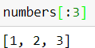
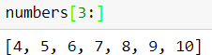
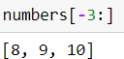
Python Fundamentals
Built-In Data Structures
Lists
Slicing
[ start index included : last index excluded]
Index | 0 | 1 | 2 | 3 | 4 | 5 | 6 | 7 | 8 | 9
List item | 1 | 2 | 3 | 4 | 5 | 6 | 7 | 8 | 9 | 10
Negative Index | -10 | -9 | -8 | -7 | -6 | -5 | -4 | -3 | -2 | -1
We can also omit the first, or last index, defaulting to the length of the index, e.g.:
-3+1= -2
-2+1= -1
Next retrieval is done by adding +1 to the current index, therefore traversal always goes in forward direction for both positive and negative index

Slide 29
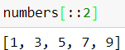
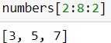
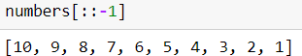
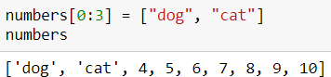
Python Fundamentals
Built-In Data Structures
Lists
Slicing
[ start index included : last index excluded : specify pace ]
Index | 0 | 1 | 2 | 3 | 4 | 5 | 6 | 7 | 8 | 9
List item | 1 | 2 | 3 | 4 | 5 | 6 | 7 | 8 | 9 | 10
Negative Index | -10 | -9 | -8 | -7 | -6 | -5 | -4 | -3 | -2 | -1
Sections of lists can be replaced as follows:

Slide 30
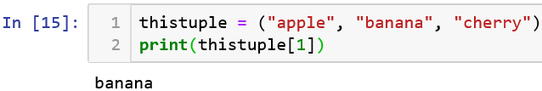
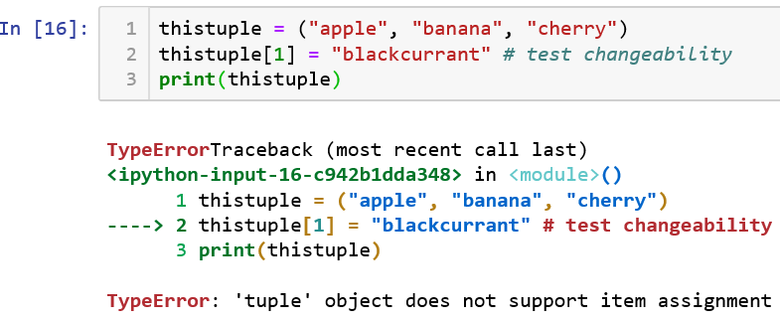
Python Fundamentals
Built-In Data Structures
Tuples
Similar to lists, however: Defined with parenthesis or no brackets.
Are Immutable (They can not be changed once created)
Slicing and indexing functions as in Lists.

Slide 31
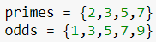
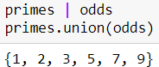
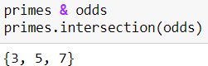
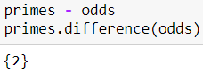
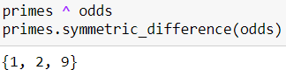
Python Fundamentals
Built-In Data Structures
Sets
Unordered collection of unique items. Will not store duplicates.
Useful operations including:
Union of sets – containing items appearing in either
Intersection of sets – containing items appearing in both
Difference in sets – containing items in set 1 but not set 2.
Symmetric Difference in sets – items appearing in only one set.

Slide 32
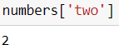

Python Fundamentals
Built-In Data Structures
Dictionaries
Unordered mappings of keys to values
Mutable
Created by comma-separated lists of key: value pairs
Items are accessed using the list indexing syntax
However, the index is a key in the dictionary, not an integer:
New entries can be added via:

Slide 33

Python Fundamentals
Variables and mutable objects
Mutable object = object whose value can change
E.g. list, set, dict
Note: Be aware when using two variables to point at the same mutable object! e.g.
Modifying y has appeared to modify x. This won’t make sense unless we remember that python variables are pointers to objects, not the objects themselves

Slide 34


Python Fundamentals
This is a list, so it can be changed using either of the variable name
x and y are pointing to the same memory location
So this memory location can be accessed either using x or y
Therefore, y.append(4) is adding 4 to the list

Slide 35

Python Fundamentals
Variables and immutable objects
Immutable object – object whose value is unchangeable once it is created
Int, float, bool, string, tuple, and other simple types
This makes arithmetic operations perform as expected, e.g.
When we call x = x * 2, we are not modifying the value of the 5 object, instead we are changing which object x points to.

Slide 36
Python Fundamentals
Mutable vs Immutable
int, float, bool, str, tuple, unicode are immutable
list, set, dict are mutable
Check the difference between variable holding mutable object and when variable holding immutable objects what happens?

Slide 37

Python Fundamentals
Objects in Python
Everything is an object!
Objects have:
attributes (metadata)
methods (functionality)
These are accessed using the dot syntax (.)
Tab auto complete helps identify available attributes and methods
Note:
In Jupyter Notebook, you must ensure the variable assignment has been executed prior to using tab auto complete
Otherwise, no suggestions, or incorrect suggestions, will be given

Slide 38
Python Fundamentals
Operators
Arithmetic Operators
Assignment Operators
Comparison Operators
Boolean Operators
Identity & Membership Operators

Slide 39
Python Fundamentals
Arithmetic Operators
Operator | Name | Description | Example
a + b | Addition | Sum of a and b | 2 + 3 = 5
a – b | Subtraction | Difference of a and b | 2 – 3 = -1
a * b | Multiplication | Product of a and b | 2 * 3 = 6
a / b | True Division | Quotient of a and b | 2 / 3 = 0.6666..
a // b | Floor Division | Quotient of a and b, without fractional parts | 2 // 3 = 0
a % b | Modulus | Remainder after division of a by b | 2%3 = 2
a ** b | Exponentiation | a raised to the power of b | 2**3 = 8
-a | Negation | The negative of a | a = 2, -a outputs -2

Slide 40

Python Fundamentals
Assignment Operators
Python contains built-in update operators for all the arithmetic operations.
Other examples:
a -= b
a *= b
a /= b
etc.

Slide 41

Python Fundamentals
Comparison Operators
To compare different values, returning True or False.
Operator | Description | Example
a == b | a equal to b | 2==2 returns True
a != b | a not equal to b | 2==3 returns True
a < b | a less than b | 1<2 returns True
a > b | a greater than b | 2>1 returns True
a <= b | a less than or equal to b | 1 <= 2 returns True
a >= b | a greater than or equal to b | 2 >= 1 returns True
They can be combined for more complicated comparisons, e.g.

Slide 42

Python Fundamentals
Boolean Operators
To compare the values of Boolean statements
Useful in control flow
and, or, not:

Slide 43

Python Fundamentals
Identity and Membership Operators
Category | Operator | Description
Identity | a is b | True if a and b are identical objects
 | a is not b | True if a and b are not identical objects
Membership | a in b | True if a is a member of b
 | a not in b | True if a is not a member of b
Identity and Equality are not the same

Slide 44

Python Fundamentals
Membership Operators
Check for membership within compound objects
This is distinctly easier to use than other languages which may require the creation of loops and equality checks

Slide 45

Python Fundamentals
Built-In Types – Simple Values
Type | Example | Description
int | x = 1 | Integers (whole numbers)
Float | x = 1.0 | Floating-point numbers (real numbers)
Complex | x = 1 + 2j | Complex numbers (real + imaginary components)
Bool | x = True | Boolean: True/False values
Str | x = ‘hello’ | String: Characters or Text
NoneType | x = None | Special object indicating nulls.
Integers
Any number without a decimal point
Division returns a floating-point type (Python 3.x)

Slide 46

Python Fundamentals
Built-In Types – Simple Values
Floating-Point Numbers
Store fractional numbers – either decimal notation (0.000005) or exponential notation (5e-6)
Can cast from int to float using:
Strings
Created with ‘single’ or “double” quotes
Many useful string functions are built in, including:
Function | Description
len(s) | Length of s
s.upper() | Make s uppercase
s.lower() | Make s lowercase
s.capitalize() | Capitalise s
s + s | Concatenation
s[0] | Access the first character in s

Slide 47
Python Fundamentals
Built-In Types – Simple Values
Boolean Type
Two possible values – True and False
Returned by comparison operators.
Note: They are case sensitive! True and False must be capitalised
The bool() object constructor can be used to generate Boolean
values based on these rules:
Type | Result | Example
Integer/Float | True if not 0 False if 0 | bool(0) returns False
None | False | bool(None)
Strings | True if not empty False if empty | bool(“”) returns False
Sequences | True if not empty False if empty empty | bool([]) returns false

Slide 48
Python Fundamentals
Built-In Types – Simple Values
None Type
A special type with only one possible value: None
Used to refer to null objects
Often the default return value for functions that do not return any
value

Slide 49

Getting Help from Documentation
Use Jupyter Notebook get information on the various classes you are using. For example, type:
<className>? - Useful information about a class or collection, e.g. docstrings, function call arguments, constructors, etc.
<className>?? - Further information, such as source code.
Note: If using QtConsole, Press ‘q’ to exit the further
information page

Slide 50


Getting Help from Documentation
Wildcards can also be used to search for objects in the current namespace. E.g., l*?
Tab Completion provides a way to explore the structure/attributes of any object you are using.
This also works with file names and directory structures.

Slide 51


Getting Help from Documentation
Information about a specific object can be obtained by:
Press Shift + Tab in Jupyter Notebook within function parameters to view the function signature:

Slide 52

Python Fundamentals
Control Flow
Conditional statements are used to execute certain blocks of code only when particular conditions are met.
If Statement:

Slide 53


Python Fundamentals
Loops
Repetitions often used to process collections
For Loop:
Optional Keywords:
Continue – Skip the remainder of the current loop and continue to the next iteration
Break – Exit the loop entirely

Slide 54

Python Fundamentals
Loops
While Loop: When the number of iterations is not known

Slide 55

Block Nesting
Block is a group of statements in a program or script
Generally, blocks can contain blocks as well, so we get a nested block structure
Python uses indentation to highlight the blocks of code
Python code structures by indentation
Whitespace is used for indentation in Python
To indicate a block of code in Python, you must indent each line of the block by the same whitespace
All statements with the same distance to the right belong to the same block of code
If a block has to be more deeply nested, it is simply indented further to the right
Keep this figure in mind when creating Python blocks

Slide 56
Quick Recap
thislist = ["apple", "banana", "cherry"] print(thislist[1])
[ ]
Access a member of List
thislist.append("orange") print(thislist)
Insert an item as the second position:
thislist.insert(1, "orange") print(thislist)
Remove
thislist.remove("banana") print(thislist)
The pop() method removes the specified index, (or the last item if index is not specified):
thislist.pop() print(thislist)

Slide 57

Quick Recap
thistuple = ("apple", "banana", "cherry") print(thistuple[1])
( )
Access a member of Tuple
Once a tuple is created, you cannot add items to it
Tuples are unchangeable
You can’t add a new index or change a value at index
thistuple[1] = "blackcurrant"
thistuple[3] = "orange"
TypeError: 'tuple' object does not support item assignment
The del keyword can delete the tuple completely:
del thistuple
tuple() Constructor
thistuple = tuple(("apple", "banana", "cherry"))
# note the double round-brackets print(thistuple)

Slide 58

Quick Recap
thisset = {"apple", "banana", "cherry"} print(thisset)
{ }
Set is a collection which is unordered and unindexed
So, cannot access items in a set by referring to an index
for x in thisset: print(x)
Change Items
Once a set is created, you cannot change its items, but you can add new items
To add one item to a set use the add() method
thisset.add("orange")
To add more than one item to a set use the update() method
thisset.update(["orange", "mango", "grapes"])
Remove Item
remove(), or the discard() method
thisset.remove("banana")
Note: If the item to remove does not exist, remove() will raise an error
thisset.discard("banana")
Note: If the item to remove does not exist, discard() will NOT raise an error

Slide 59
Quick Recap
thisdict = { "brand": "Ford", "model": "Mustang", "year": 1964 } print(thisdict)
{ }
with Key : Value pair
Note: In this case Key is a string so should be within “ ”
Looping:
Print all key names
for x in thisdict: print(x)
Accessing Items:
x = thisdict[ "model" ]
Or
x = thisdict.get("model")
Print all values
for x in thisdict: print(thisdict[x])
Change Values:
thisdict["year"] = 2018
for x in thisdict.values(): print(x)
Both keys and values, by using the items() function
for x, y in thisdict.items(): print(x, y)

Slide 60

Quick Recap
When you are unsure of the datatype of a variable→ use ? with the variable name

Slide 61
Python programming (Part 2)

Slide 62
Functions

Slide 63
Python Fundamentals
Defining and Using Functions
For Readability and Reusability
Using Functions
Called using Parenthesis ( )
E.g. print(‘hello’)
“print” is the function name
‘hello’ is an argument (a value passed to the function for processing)

Slide 64

Python Fundamentals
First define function using def
Then call function using defined name
Keyword Arguments
Specified by name
E.g. print (address, postcode, telNum)

Slide 65


Keyword vs Non-keyword
Keyword:
name=value instead of using positional syntax
Keyword (named) arguments
e.g. my_function(a=12, b="abc")
NOTE: Order doesn’t matter when they’re passed by their name

Slide 66


Keyword vs Non-keyword
Non-keyword:
Arguments as positional arguments
NOTE: Order of these arguments matters when they’re passed positionally

Slide 67

Python Fundamentals
Defining Functions
Note:
No need to declare any input or return type
Multiple values can easily be returned in a tuple, e.g.:
return houseNumber, street, county, country, postcode

Slide 68


Python Fundamentals
A note on assignment

Slide 69


Note: Indentation Error
Variables L, a, and b are within the def function so they have to be indented to let the interpreter know where they belong to
Same problem here as well. The code below while has to be written after a tab, to reflect belonging to while loop

Slide 70


Correct format
Because return is part of the function so should be inside

Slide 71

Python Fundamentals
Default Argument Values
Facilitate speed and ease of use, yet provide flexibility
When there are values a function should use most times, but not always
These default values do not need to be specified when calling the function, e.g.
NOTE: See first value only passed rest is default used
when function called

Slide 72


Python Fundamentals
Default Argument Values
They can be provided in order:
If they are specifically named, they can be provided in any order (But must be AFTER the non-keyword args):

Slide 73

Python Fundamentals
Default Argument Values
You can view the default arguments of functions
Simply write the function call, e.g. animals. sort()
Place the cursor within the parenthesis
Press Shift + Tab
This example shows two parameters and their default values

Slide 74
Python Fundamentals
Flexible Arguments:
*args and **kwargs → Special syntax
Facilitate writing a function without knowing how many arguments a user will pass
Used in function definitions to pass a variable number of arguments to a function
The name “args” and “kwargs” are just variable names used by convention
Asterisks are the important part
* before a variable = “expand this as a sequence”
** = “expand this as a dictionary”
{Because Dictionary variable are key value pair}

Slide 75
Python Fundamentals
*args→ non-keyword arguments
Single asterisk form (*args) is used to pass a non-keyworded, variable-length argument list
When not wanting to restrict the number of non-keyword arguments that can be accepted
**kwargs→ keyword arguments
Double asterisk form is used to pass a keyworded, variable-length argument list
When not wanting to restrict the number of keyword arguments that can be accepted

Slide 76




Python Fundamentals
Example:
* use→ non-keyword argument
** use→ keyword argument
Both
non-keywords passed
keywords passed

Slide 77



Python Fundamentals
Python Lambda
Is a small anonymous function
Syntax→ lambda arguments : expression
Can take any number of arguments, but can only have one expression
- Can take any number of arguments, but can only have one expression
lambda way
function way

Slide 78
Iterators

Slide 79


Python Fundamentals
Iterators
Facilitate proceeding through a dataset and repeating
similar calculations
One task – return the “next” item in an iterable
The end=' ' is just to say that you want a space after the end of the statement (i.e. after each value) instead of a new line character
Value separated by commas in this case

Slide 80



Python Fundamentals
Iterating over lists
When writing for [value] in [list], the Python interpreter checks whether it has an iterator interface
This can be checked yourself by:

Slide 81

Note on range ( ) function
Returns a sequence of numbers
Starting from 0 by default
Increments by 1 (by default)
Stops before a specified number
0 to 9
0 to 9
1 to 9
0 to 10

Slide 82


Note on range ( ) function
When * is used→ the sequence get expanded and passed element by element to the print function
In this case just the range function with arguments passed is printed and not the actual sequence
NOTE: * expand the arguments as sequence

Slide 83

Python Fundamentals
The iterator object provides the functionality required by the for loop
It is a container providing access to the next object (if valid) using the next( ) function
So if you do this, for internally calls the next() and check if more values is there, it will retrieve

Slide 84



Python Fundamentals
Why is this useful?
It allows Python to treat things as lists when they are not actually lists (e.g. the range object)
The range( ) function returns a range object:
Like a list, the range object exposes an iterator:
So Python can treat it as if it is a list:

Slide 85


Python Fundamentals
Why is this useful?
The full list is never explicitly created
This is very memory efficient, as large lists could take up massive amounts of memory
E.g.
Iterators can also be infinite, with no end value
E.g. The count function of the itertools library

Slide 86


Python Fundamentals
Other Useful Iterators
enumerate
Helps keep track of the current index
Instead of:
len(animals)→ returns 3
Then range(3) returns: [0, 1, 2]
enumerate makes this much more elegant:
Enumerate returns two values:
1. index
2. actual value in the list

Slide 87

Python Fundamentals
Other Useful Iterators
zip
To iterate over multiple lists simultaneously
NOTE:
Can be performed with more than 2 iterables
The shortest iterable determines the length

Slide 88



Python Fundamentals
→ map
Takes a function, and applies it to the values in an iterator
Therefore 2 arguments:
- function that needs to be applied
- sequence on which it needs to be applied
Take each value from range and apply the function square
→ filter
Similar, but only passes through values for which the filter function evaluates to True
Also takes 2 arguments

Slide 89

Python Fundamentals
Iterators as Function Arguments
*args and **kwargs can be used to pass sequences and dictionaries to functions
*args can accept iterators:
e.g.
* for list
** for dictionary
Here it means you are passing a variable length arguments to the print function

Slide 90
Python Fundamentals
Iterators as Function Arguments
What would the following output?

Slide 91
Python Fundamentals
Iterators as Function Arguments
What would the following output?
Answer:

Slide 92

Python Fundamentals
Specialised Iterators: itertools
The itertools module contains many useful iterators
The official docs have a full list of iterators:
https://docs.python.org/3.6/library/itertools.html
Examples:
permutations
Iterates over all permutations (orders/arrangements) of a sequence

Slide 93


Python Fundamentals
Specialised Iterators: itertools
combinations
Iterates over all unique combinations of N values in a list:
product
Iterates over all sets of pairs between 2 iterables:
Today’s practical will give you experience of these and more

Slide 94

Python Fundamentals
Specialised Iterators: itertools

Slide 95
Errors and Exception

Slide 96
Python Fundamentals
Errors and Exceptions
Common errors include:
Syntax Errors – Where code is not valid Python code
Runtime Errors – Where syntactically valid code fails to execute
(potentially due to user input)
Semantic/Logic Errors – Code executes, but result is not as expected

Slide 97


Python Fundamentals
Syntax Errors
Syntax errors occur when the parser detects an incorrect statement

Slide 98


Python Fundamentals
Runtime Errors
Can happen in many different ways, including:
Referencing an undefined variable or function:
Attempting an undefined operation:
→ int and str can not be added

Slide 99


Python Fundamentals
Runtime Errors
Attempting to compute a mathematically ill-defined result:
Accessing an out of range index:

Slide 100

Python Fundamentals
Summing Up
raise allows you to throw an exception at any time
assert enables you to verify if a certain condition is met and throw an exception if it isn’t
In the try clause, all statements are executed until an exception is encountered
except is used to catch and handle the exception(s) that are encountered in the try clause
else lets you code sections that should run only when no exceptions are encountered in the try clause
finally enables you to execute sections of code that should always run, with or without any previously encountered exceptions

Slide 101
List Comprehensions

Slide 102

Python Fundamentals
[ ]
List Comprehensions
Two expressions:
- function that needs to be applied
- sequence on which it needs to be applied
Concise way to create lists
Common applications are:
To make new lists where each element is the result of some operations applied to each member of another sequence or iterable
To create a subsequence of those elements that satisfy a certain condition
Example:
Non-concise approach
Concise approach
squares =((lambda x: x**2, range(10)))
or, equivalently:
squares = [x**2 for x in range(10)]
→ for loop in one line of code
Directly assign the output to a variable
List returned

Slide 103


Python Fundamentals
List Comprehensions
Non-succinct version:
List Comprehension version:
Read like: “Construct a list consisting of the square of n for each n up to 11”
List Comprehension Syntax:
[expression for variable in iterable]

Slide 104

Python Fundamentals
List Comprehensions
Multiple Iterations:
To build up a list from more than one value
Add an additional for expression, e.g.:
The first for is the “exterior index”
The second for is the “interior index” – varying the fastest in the resulting list
Two expression
Two for
Two iterable

Slide 105

Python Fundamentals
List Comprehensions
Conditionals on the Iterator
Added to the end of the expression
This example will only output values where m is an even number.
Equivalent loop syntax is much more long winded:

Slide 106


Python Fundamentals
List Comprehensions
Conditionals on the Value
Syntax:
a if condition else b
condition is first evaluated, then either a or b is returned based on the Boolean value of condition
If condition evaluates to True then a is returned
If condition evaluates to False then b is returned
e.g.
or:

Slide 107

Python Fundamentals
List Comprehensions
if val%2 else –val→ Do something
Conditionals on the Value
More complex example:
if val%3→ Do nothing
Constructing a list which leaves out multiples of 3 and negate all
values in the list that are multiples of 2

Slide 108
Python Fundamentals
List Comprehensions
Conditionals on the Value
More complex example:
Step 1: Use an iterator returning values from 0 to 19

Slide 109
Python Fundamentals
List Comprehensions
Conditionals on the Value
More complex example:
Step 1: Use an iterator returning values from 0 to 19
Step 2: Iterator conditional – only create a list of values that are not multiples of 3 (i.e. val % 3 returns a value other than 0)

Slide 110
Python Fundamentals
List Comprehensions
Conditionals on the Value
More complex example:
Step 1: Use an iterator returning values from 0 to 19
Step 2: Iterator conditional – only create a list of values that are not multiples of 3 (i.e. val % 3 returns a value other than 0)
Step 3: Value conditional – In values returned from step 2, return the current value if it is not a multiple of 2 (i.e. val % 2 returns a value other than 0)

Slide 111
Python Fundamentals
List Comprehensions
Conditionals on the Value
More complex example:
Step 1: Use an iterator returning values from 0 to 19
Step 2: Iterator conditional – only create a list of values that are not multiples of 3 (i.e. val % 3 returns a value other than 0)
Step 3: Value conditional – In values returned from step 2, return the current value if it is not a multiple of 2 (i.e. val % 2 returns a value other than 0)
Step 4: Value conditional continued – otherwise, return every other value as a negative

Slide 112



Python Fundamentals
Other Comprehensions
Set Comprehensions
Use curly brackets instead
Remember – sets will remove all duplicates
Dict Comprehensions
Return 2 values separated by a colon (:)
Generator Expression

Slide 113
Python programming (Part 3)

Slide 114
Data Wrangling
Aka. “Data Munging”
The process of cleaning and formatting data, transforming it from its raw form into a format that is more usable for further analysis
“Most data scientists spend much of their time cleaning and formatting data. The rest spend most of their time complaining that there is no available data to do what they want to do!”
S.S Skiena, The Data Science Design Manual (2017)
Garbage In = Garbage Out

Slide 115

Dirty Data Sample

Slide 116
What is a “good” data format?

Slide 117
Data Formats
Good data formats could be:
Easy for computers to parse – A logical and consistent format
Easy for people to read – “Eyeballing” data can be an essential operation in many scenarios. E.g.
Which of the files in this directory is the right one?
What information do these data fields really contain?
What range of values can be expected from a particular field?
This may be through use of clear delimiting symbols, human- readable text-encoded formats, etc.
Widely used by other tools and systems -
This allows mixing and matching data from various resources, best facilitated through using popular standard formats

Slide 118
Data Formats
Most common data formats:
CSV – Comma Separated Value
XML – eXtensible Markup Language
JSON - JavaScript Object Notation
Database

Slide 119

Data Formats
CSV – Comma Separated Value
Field names in the first row
Each value separated by a comma (or other delimiter)
Delimiter – one or more characters used to specify the boundary between separate regions in data
Each row separated by a carriage return
Notepad++ for eyeballing (or a spreadsheet application)

Slide 120


Data Formats
CSV – Comma Separated Value
Notepad++ for eyeballing (or a spreadsheet application)
Notepad++ can show all characters

Slide 121

Data Formats
JSON – JavaScript Object Notation
Lightweight data format
Human and Machine-readable
Name: Value pairs
Objects held in curly brackets { }
Arrays held in Square Brackets [ ]
Syntax for storing and exchanging data

Slide 122
Data Formats
JSON
A syntax for storing and exchanging data
It is a text
Written with JavaScript object notation
In client/server communication JSON objects are passed

Slide 123
Data Formats
Why use JSON?
JSON format is text only→
Easy to send to and from a server
Used as a data format by any programming language
JavaScript has a built in function to convert a string, written in JSON format, into native JavaScript objects:
JSON.parse()

Slide 124
Data Formats
JSON
Syntax Rules: Derived from JavaScript object notation
Data is in name(key): value pairs
Data is separated by commas
Curly braces hold objects
Square brackets hold arrays
myJson={ "name":"John" }
JSON Object
key : value
Note: keys must be strings, written with double quotes

Slide 125
Data Formats
JSON
Start and end of JSON object
myObj = { "name":"John", "age":30, "cars":
[ {"name":"Ford","models":["Fiesta","Focus", Mustang"] }, { "name":"BMW", "models":[ "320", "X3", "X5" ] }, { "name":"Fiat", "models":[ "500", "Panda" ] } ] }
myObj has three data each separated by comma
3 JSON object
The key “cars” has more complex value
value is array
array has three objects
Each object has data “name” and “models”
“models” key has array of string values

Slide 126

Data Formats
JSON
http://jsonviewer.stack.hu/

Slide 127
Files in Python
– Reading Files

Slide 128


Reading Files in Python
Let’s assume you have a sample text file you wish to process

Slide 129
Files in Python
Syntax of Python open file function
file_object = open("filename", "mode")
filename: gives name of the file that the file object has opened
mode: attribute of a file object tells you which mode a file was opened in
Mode | Description
'r' | This is the default mode. It Opens file for reading.
'w' | This Mode Opens file for writing. If file does not exist, it creates a new file. If file exists it truncates the file.
'x' | Creates a new file. If file already exists, the operation fails.
'a' | Open file in append mode. If file does not exist, it creates a new file.
't' | This is the default mode. It opens in text mode.
'b' | This opens in binary mode.
'+' | This will open a file for reading and writing (updating)

Slide 130

Files in Python
Interact with this file by creating a file object, using the open function
Note:
Arguments (r, w, a, r+) are used to define the mode by which the file is opened
The close function must be called after interaction is complete so no limits are reached
‘r+’ mode will open a file in read and write mode

Slide 131
Read Text File in Python
To read text file in Python:
Call open() builtin function with filepath and mode passed as arguments. open() function returns a file object
Call read() method on the file object. read() returns a string
The returned string is the complete text from the text file

Slide 132

Read Text File in Python
Example:
The myFile object is an iterator which returns the next line in the file until the end is reached
You can provide the complete or absolute path to the open() function

Slide 133

Reading Files in Python
What could go wrong?

Slide 134




Read Text File Line by Line
readline() function
Read text line by line from a file→File.readline() function
Returns the current line and updates its pointer to the next line
So, when readline() function is called for the next time, the next line is returned
LineFiles.txt
This is 1st line
This is 2nd line
This is 3rd line
This is 4th line
This is 5th line

Slide 135
Reading Files in Python
What could go wrong?
A try… finally clause could handle this
Python offers a convenient way of doing this

Slide 136


Reading Files in Python
The with statement automatically closes a file upon exiting the code block, even if an exception occurs
The basic structure is as follows:
As before, use a for loop to iterate through each line in the file:

Slide 137

Reading Files in Python
Note: with statement has colon (:) to start the code block
Therefore, all the file handling operation should go within this block
As soon as you come out of this block the file will close

Slide 138

Python Modules
A module is a Python file that consists of Python code
Modules can define functions, classes, and variables that can be referenced in other Python files
They are imported using the import statement:
Include any import statements at the top of your file or notebook
Once a module is imported, objects within the module can be accessed and used

Slide 139


Python Modules
More on Modules:
Functions/Statements/Variables within a module can be accessed using the syntax:
<ModuleName>.<ObjectName>

Slide 140


Python Modules
More on Modules:
A specific function in a module can be imported and called as follows:
Directly called
Modules can be aliased, i.e. referred to as a different name as follows:

Slide 141
Reading CSV Files in Python
CSV Files can be read with the use of a csv . reader
This must be imported from the csv module

Slide 142


Reading CSV Files in Python
A csv . reader is used very similarly to our previous file object:
Complete full row value is in row variable for each iteration
Get each value per column in a particular row

Slide 143

Reading CSV Files in Python
The output:

Slide 144
Reading CSV Files in Python
DictReader( )
Iterating over normal file, each iteration of the loop produces a single string that represents the contents of that line
Iterating over CSV file, each iteration of the loop produces a dictionary from strings to strings
Dictionary is returned, therefore key= value pair
keys are the names of the columns (from the first row of the file, which is skipped over)
Values are all the rows' values for each of the column

Slide 145


Reading CSV Files in Python
id | name | age | height | weight
1 | Alice | 20 | 62 | 120.6
2 | Freddie | 21 | 74 | 190.6
3 | Bob | 17 | 68 | 120
DictReader( )
Getting all the headers of people.csv
Note: all the code belongs to the with open() block, so do the correct indentation

Slide 146


Reading CSV Files in Python
id | name | age | height | weight
1 | Alice | 20 | 62 | 120.6
2 | Freddie | 21 | 74 | 190.6
3 | Bob | 17 | 68 | 120
DictReader( )
One key has multiple values
Therefore, if a particular column called all the values for that column will be returned
print (row ['name’]) → gets all the values for the name header

Slide 147

Reading CSV Files in Python
An example with more complex data
Source:
OpenDataNI – Food Premise Hygiene Ratings

Slide 148

Reading CSV Files in Python
The csv module’s DictReader can provide each column as a dict with the headers as keys:
Getting all the rows of column named establishmentname
Header as key and then you can get complete column as value

Slide 149
Writing to Files in Python

Slide 150
Writing to Plain Text Files in Python
We may wish to save any results for future reference
Writing plaintext files is a very straightforward
As with reading, we first create a file object
The file is opened in one of the following modes: w, r+, a
We then use the write function to output the desired values
Finally, we must close the file

Slide 151


Writing to Plain Text Files in Python
Example-New file
"w" - Write - will overwrite any existing content

Slide 152


Writing to Plain Text Files in Python
Example-Existing file
Writing to the existing file- demofile2.txt
Append - will append to the end of the file

Slide 153



Writing to CSV Files in Python
Writing to CSV files requires a CSV Writer
This will automatically convert provided data into delimited strings and output to the desired file
Again, this must be imported from the csv module

Slide 154


Writing to CSV Files in Python
Experimenting with “append” mode (a)
Specifying mode “w” will overwrite the file each time it is opened
Append mode (a) will append data to the end of an existing file, e.g.

Slide 155
We hope this set of notes will cover some of the fundamental aspects of Python programming and give you a good headstart going into the Autumn School! The lab session on Day 1 will cover further relevant applications and examples There are also many other resources online that you can explore on your own, e.g. https://www.datacamp.com/

